Slide 1
Python – Data Cleansing

Slide 2


Slide 3

30 Days Python Master Class
Day1 : Python
Time: 6.00 PM IST
Free Registration

Slide 4
Python Master Class
Handbook

Slide 5
NANDHINI.S
Exp: 5 Yrs
Expert in
Python Developer on Machine Learning
Deep learning with computer vision
Matlab – Image Processing
Autonomous Car design using ROS with LIDAR
Language – Python , Java , HTML ,CSS.
Tools – ANACONDA NAVIGATOR, JUPYTER NOTEBOOK,
GOOGLE COLAB.
Graduation : BE – ECE | 2011

Slide 6
Pantech?
Educational Equipment Manufacturer
IoT, AI, Robotics,Autonomous Robot
Microprocessor/Microcontroller
DSP,VLSI, Embedded System
Power Electronics & Drives, Fuel Cell Trainer Kit
Renewable Energy Lab, Electric Vehicle Lab
Technical Training
DIY Project

Slide 7

What is Master Class ?
👍 This is the 30 Days Industrial Learning Activity.
👍 Its Online YouTube Live Class
👍 If you Invest 45 minutes daily, U will become Master in Data Science
👍 You will get FREE E-Certificate
Webinar Participation Certificate
“Learning is the beginning of wealth.
Searching & Learning is where the miracle process all begins.” …………….Jim Rohn

Slide 8
Our Vision
Help 10 Million Students to Learn the Technology in Easy Way

Slide 9

Associate Partner for this Master Class
https://apssdc.in/home/

Slide 10
What U will Learn from 30 Days Data Science & Analytics Master Class

Slide 11
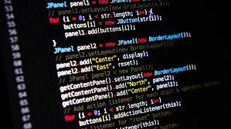
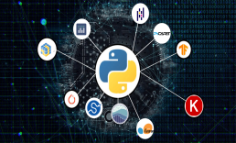



Python Learning Plan
01
02
03
04
05
Library
Python
Analytics
Analytics
Industry Project
Introduction To Python and Python Data Structures
Pandas
Numpy
MatplotLib
Cborn, SKLearn Lib
Collab
Distribution
Visualization
Aggregation
Statistics
Distribution Function
Project Building

Slide 12
Day wise Learning Plan
Day -1 : Introduction to Python
Day -2: Python – Tools|Syntaxes & Data Structures
Day -3: Python – Dictionaries,Date and Time
Day -4: Python – MySql
Day -5: Pandas library – Introduction
Day -6: Pandas library – Data Structures
Day -7: Numpy library – Introduction
Day -8: Numpy library – Array Manipulations, Mathematical Functions
Day -9: Matplotlib , Histogram Using Matplotlib | I/O With Numpy
Day -10: Matplotlib Library - Introduction , Pyplot API | Types Of Plots
Day -11: Seaborn Library
Day -12: SKLearn Library
Day -13: Python – Date and Time , Data Wrangling.
Day -14: Python – Data Cleansing
Day -15: Python – Word Tokenization , Stemming and Lammetization.

Slide 13
Day wise Learning Plan
Day -16: Python – Data Visualization
Day -17: Python – Statistical Analysis
Day -18: Python – Types Of Distribution
Day -19: Python – Correlation ,Chi-Square Test , Linear Regression
Day -20: Keras library – Introduction.
Day -21: Stock Price Prediction With Machine Learning LSTM RNN
Day -22: People’s behaviour in chat message using NLP NLP
Day -23: Gaming In Python
Day -24: Chatbot creation in Python NLP
Day -25: Electricity Price Prediction Using ML Random Forest Regressor
Day -26: Diamond Price Prediction Using Python Linear Regression
Day -27: Book Recommendation System KNN
Day -28: Image Classification Using CNN CNN
Day -29: Titanic Survival Analysis Using ML Logistic Regression
Day -30: Blockchain in Python

Slide 14
List of Projects for Demo in YouTube Live
Stock Price Prediction With Machine Learning
People’s behaviour in chat message using NLP
Gaming In Python
Chatbot creation in Python
Electricity Price Prediction Using ML
Diamond Price Prediction Using Python
Book Recommendation System
Image Classification Using CNN
Titanic Survival Analysis Using ML
Blockchain in Python
All Projects in Jupyter Notebook

Slide 15
What you will get from this Free 30 Days Master Class?
You can attend YouTube Live Class
Free E-Certificate ( WEBINAR PARTICIPATION CERTIFICATE)

Slide 16
How to mark your Attendance in YouTube Live Class?
Ans : During the Live Class, organizer will post Google Form link in Live Chat. The Participants should submit the from on daily basis. Minimum 25 Days Attendance is Required to get Free Master Class Participation Certificate.
Note : The Link will be available during the Live. From the LIVE Class date, the live video will get removed from the YouTube in 3 days.

Slide 17
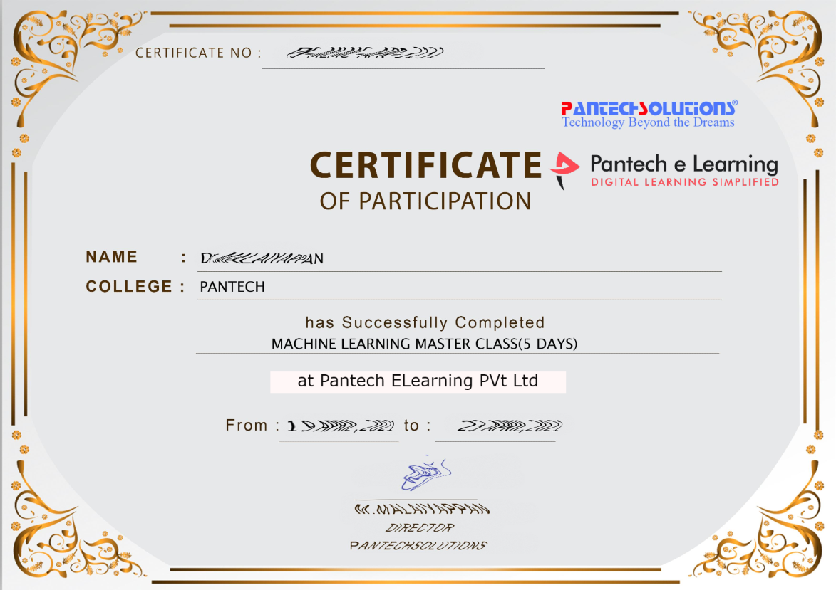

Sample Webinar Participation Certificate?

Slide 18
https://www.pantechelearning.com/data-science-master-class/
On Demand
You can get chance to apply 1 Month Internship on Data Science & Analytics Master Class

Slide 19
What is Internship????
Learn
Practice
Verify
Get Certified
Grow

Slide 20
Free Master Class DSA | 1 Month Internship on DSA
Master Class Participation Certificate | Internship Completion Certificate
Minimum 25 Class should attend YouTube Live | Recorded Class Link will be provided. – LMS Portal Access
YouTube Live Mandatory | Your Choice. You can attend Live or else You can watch Recorded Class in LMS Portal
All Projects Demo class in YouTube Live | Step by Step Video Explanation Content in LMS Portal
Access : 3 Days | VIP WhatsApp Group Support
 | You Can Download All PPTs
 | 4 Nos of Hackathon Class in Zoom Live. The Recording also will be provided
 | You Can Download All Project Files
 | Mentor will guide you to finish 10 Projects
 | Access : 60 Days

Slide 21
Pantech will make you to Create 10 Projects in Data Science & Analytics in 30 Days
Objective of this 30 Days Master Class

Slide 22
1 Month Internship in Data Science
INTERNSHIP E-Certificate(30Days Internship on Data Science Engineering)
Highly organized Video content
Download All Files
Download PPTs
Assignments
Flexible Time.
Access Period: 60Days from the date of payment

Slide 23
What You Will Get???
Complete Project Files
30 Days Learning Activity
Data Science Core Concepts
10 + Projects
Project PPT
Spatial Data Science For Covid-19 Disease Prediction
Parkinson’s Disease Prediction-XGBoost Classifier
House Price Prediction-Random Forest Regression
Customer Segmentation Using ML-K-Means Clustering
Home Loan Prediction-Decision Tree Classifier
Spam Classification-NLP
Hand Written Digit Recognition Using Python-CNN
Churn Prediction-Deep Learning
Crop Yield Prediction
Ground water level prediction
Video Class Access for 2 Months
Get chance to Enroll 1-Month Internship on demand

Slide 24
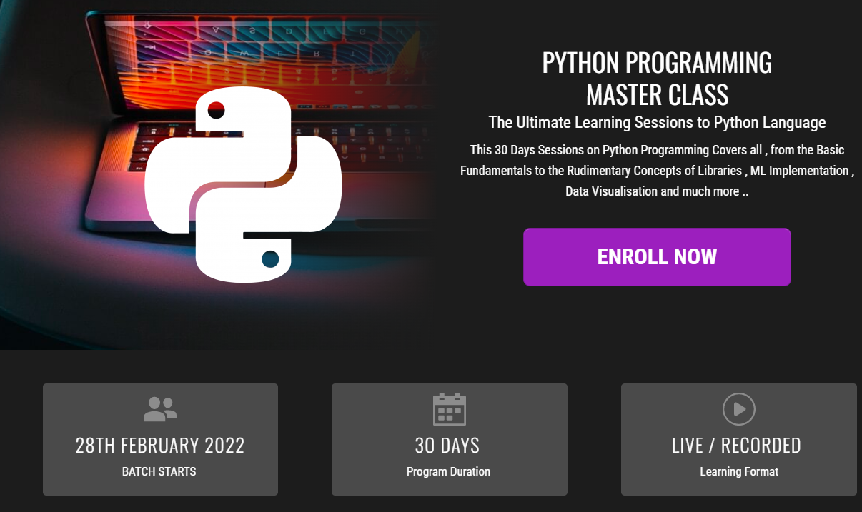
How to join in 1 month Internship
https://www.pantechelearning.com/pymc-internship/
Coupon Code: PYMC

Slide 25
Handling Missing Data
Quality data must be provided to the machine learning model in order to improve the overall efficiency of the process.
If some data is missing , it is going to affect the accuracy of the entire process.

Slide 26
Handling Missing Data
# import the pandas library
import pandas as pd
import numpy as np
df = pd.DataFrame(np.random.randn(5, 3), index=['a', 'c', 'e', 'f', 'h'],columns=['one', 'two', 'three'])
df = df.reindex(['a', 'b', 'c', 'd', 'e', 'f', 'g', 'h'])
print (df)

Slide 27
Output:
one two three
a 0.077988 0.476149 0.965836
b NaN NaN NaN
c -0.390208 -0.551605 -2.301950
d NaN NaN NaN
e -2.000303 -0.788201 1.510072
f -0.930230 -0.670473 1.146615
G NaN NaN NaN
h 0.085100 0.532791 0.887415

Slide 28
Handling Missing Data
ReIndexing is used to create a DataFrame with missing values.
In the output , NaN means not a number.

Slide 29
Check For Missing Values
Pandas contains some inbuilt functions like isnull() and notnull() functions in order to detect the missing values.
import pandas as pd
import numpy as np
df = pd.DataFrame(np.random.randn(5, 3), index=['a', 'c', 'e', 'f', 'h'],columns=['one', 'two', 'three'])
df = df.reindex(['a', 'b', 'c', 'd', 'e', 'f', 'g', 'h'])
print df['one'].isnull()

Slide 30
Output
a False
b True
c False
d True
e False
f False
g True
h False
Name: one, dtype: bool

Slide 31
Cleaning Missing Data
This library provides various methods in order to clean the missing values.
The fillna function can “fill in” NA values with non – null data in a couple of ways .

Slide 32
Replace NaN With a Scalar Value
import pandas as pd
import numpy as np
df = pd.DataFrame(np.random.randn(3, 3), index=['a', 'c', 'e'],columns=['one', 'two', 'three'])
df = df.reindex(['a', 'b', 'c'])
print (df )
print ("NaN replaced with '0':")
print (df.fillna(0))

Slide 33
Output
one two three
a -0.576991 -0.741695 0.553172
b NaN NaN NaN
c 0.744328 -1.735166 1.749580
NaN replaced with '0':
one two three
a -0.576991 -0.741695 0.553172
b 0.000000 0.000000 0.000000
c 0.744328 -1.735166 1.749580

Slide 34
Fill NA Forward and Backward
Method Action
Pad/fill Fills method Forward
Bfill/backfill Fill method backward.

Slide 35
Fill NA Forward and Backward
import pandas as pd
import numpy as np
df = pd.DataFrame(np.random.randn(5, 3), index=['a', 'c', 'e', 'f', 'h'],columns=['one', 'two', 'three'])
df = df.reindex(['a', 'b', 'c', 'd', 'e', 'f', 'g', 'h'])
print (df.fillna(method='pad'))

Slide 36
Output
one two three
a 0.077988 0.476149 0.965836
b 0.077988 0.476149 0.965836
c -0.390208 -0.551605 -2.301950
d -0.390208 -0.551605 -2.301950
e -2.000303 -0.788201 1.510072
f -0.930230 -0.670473 1.146615
g -0.930230 -0.670473 1.146615
h 0.085100 0.532791 0.887415

Slide 37
Drop Missing Values
If we want to exclude the missing values , use the dropna function along with the axis argument.
If any value within a particular row has a NA value , then the whole row will be excluded.

Slide 38
Drop Missing Values
import pandas as pd
import numpy as np
df = pd.DataFrame(np.random.randn(5, 3), index=['a', 'c', 'e', 'f', 'h'],columns=['one', 'two', 'three'])
df = df.reindex(['a', 'b', 'c', 'd', 'e', 'f', 'g', 'h'])
print (df.dropna())

Slide 39
Output
one two three
a 0.077988 0.476149 0.965836
c -0.390208 -0.551605 -2.301950
e -2.000303 -0.788201 1.510072
f -0.930230 -0.670473 1.146615
h 0.085100 0.532791 0.887415

Slide 40
Replace Missing / Generic Values
If we want to replace a generic value with a specific value , then replace method can be used.
Replacing NA with a scalar value is equivalent behaviour of the fillna() function.

Slide 41
Replace Missing / Generic Values
Example:
import pandas as pd
import numpy as np
df = pd.DataFrame({'one':[10,20,30,40,50,2000], 'two':[1000,0,30,40,50,60]})
print (df.replace({1000:10,2000:60}))

Slide 42
Replace Missing / Generic Values
Output:
one two
0 10 10
1 20 0
2 30 30
3 40 40
4 50 50
5 60 60

